Slide 1
Project 4
Dimitri Short, Kyle Dunn

Slide 2
New Additions
Implemented the remaining sorting algorithms.
Implemented Data collection processes to collect and organize performance data for each algorithm. It counts waiting time for process and memory usage efficiency.

Slide 3
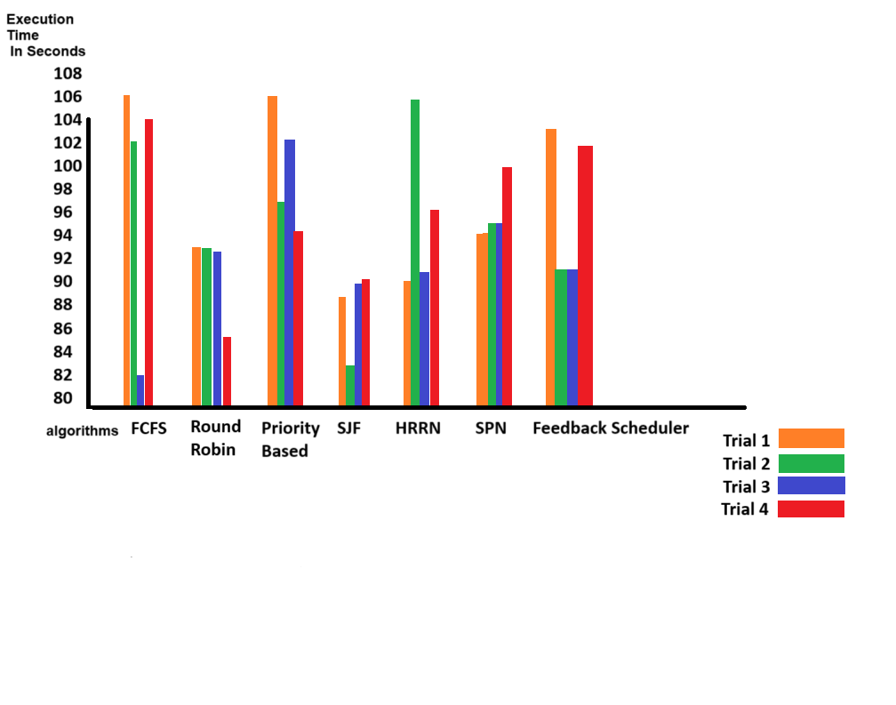

Slide 4
Fastest & Slowest
Shortest Process Next(SPN) was the fastest because by going with the shortest processes first it reduces the average execution time. this help with getting the smaller tasks done first, opposed to trying to complete the larger tasks first and leaving the smaller ones undone.
Priority-Based Scheduling was the slowest because it takes in tasks based on assigned priority with no idea of efficiency. With High Priority tasks not receiving the correct priority can lead to increasing the execution time.

Slide 5
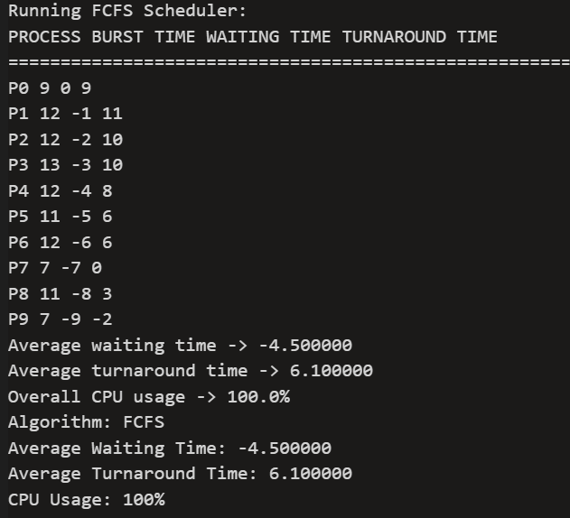
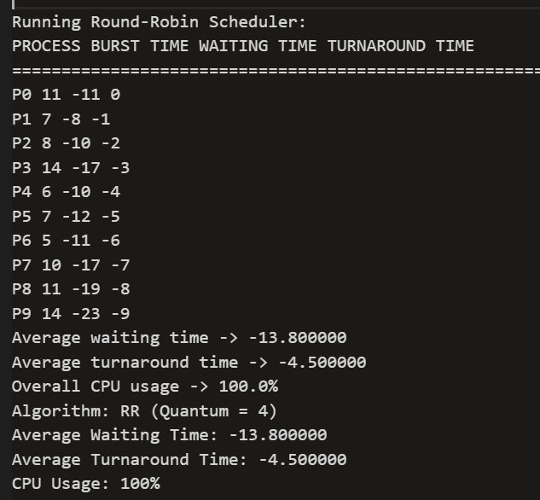
Output FCFS and Round-Robin

Slide 6
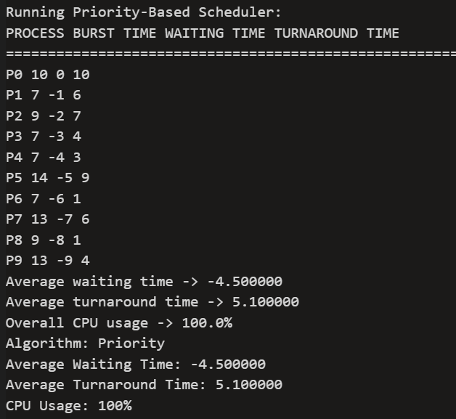
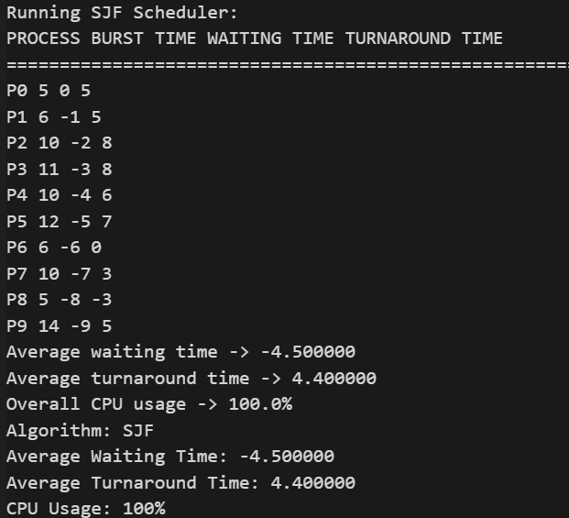
Output Priority-Based, Shortest Job First(SJF)

Slide 7
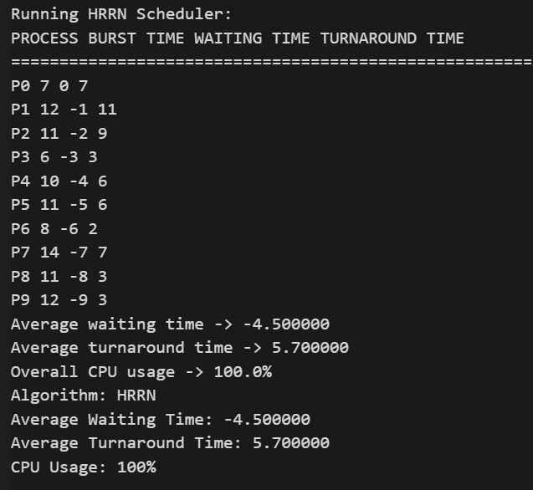
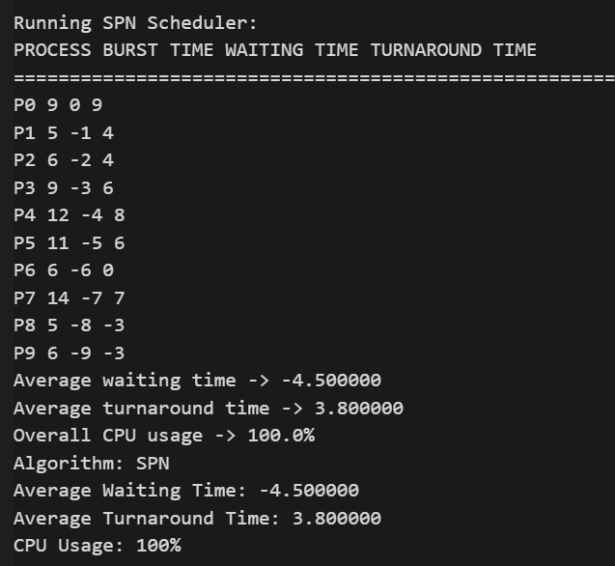
Output Highest Response Ratio Next(HRRN) shortest process next(SPN)

Slide 8
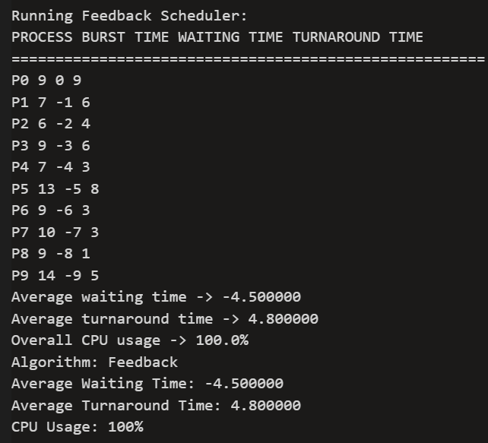
Output Feedback Scheduler

